Slide 1

FACULTY OF ENGINEERING AND TECHNOLOGY
COMPUTER PROGRAMMING
ASSIGNMENT PRESENTATION OF MATLAB
PRESENTED TO; MR.MASERUKA BEN
BY;GROUP 6
DATE;22/09/2025

Slide 2
GROUP MEMBERS
NAME | REG.NO | COURSE
MUWAZA DEOGRATIUS | BU/UP/2024/5398 | PTI
OPIO SAM ODWORI | BU/UP/2024/4454 | WAR
KATUNGUKA EMMANUEL | BU/UP/2024/1030 | WAR
JOAN RACHEAL LAGU | BU/UP/2024/1028 | WAR
KISAKYE PRISCILLA PATIENCE | BU/UP/2024/1034 | WAR
AYOO LINDA | BU/UP/2024/5097 | AMI
WAMBASA GEOFERY | BU/UP/2024/3259 | WAR
NAMANYA PRECIOUS | BU/UP/2024/5255 | AMI
NANGOLI DERRICK | BU/UP/2024/3736 | AMI
APUDA CECILIA LINDI | BU/UP/2024/3248 | WAR

Slide 3
PROBLEM STATEMENT
The group was assigned to utilize the knowledge of algorithm development, control structures and modules 1-4 to come up with all numerical approximation method for the solutions to a function such as though not limited to, the secant, the bisection method , all methods for solving differential equations numerically such as Euler and Runge-Kutta and applying them in practical real- world plots.

Slide 4
OBJECTIVES OF PROJECT:
To learn how to implement algorithm development in MATLAB.
To learn how to apply different numerical methods in real world practical plots
To be able to plot different numerical data on graphs and compare them with different analytical problems.

Slide 5
METHODOLOGY
First and foremost, each member was given a task to research about the assignment before our first meeting. The research concepts were obtained through watching tutorials as well as harnessing and resourced knowledge from continuing students especially year 3’s and 4’s.

Slide 6
QUESTION
In your different groups, utilize the knowledge of algorithm development, control structures and modules 1-4 on the following problems.
(a) All numerical approximation methods for finding the solutions to a function. This includes but not limited to secant, bisection method…
(b) All methods for solving differential equations numerically and these include Euler formular, Runge- kutta
(c) Ensure to apply (a) and (b) on a practical real-world plot
NB Ensure that the different methods are tested on similar programs (minimum of 2)
This will help you plot graphs that compare the problem analytical solutions to different methods a long with the computation time.

Slide 7
NUMERICAL METHODS
1. NEWTON-RAPHSON METHOD
%% Newton-Raphson Method
fprintf('=== NEWTON-RAPHSON METHOD ===\n');
fprintf('Business Break-Even Analysis\n');
fprintf('Price: $%.0f, Fixed Cost: $%.0f, Variable Cost: $%.0f\n\n', Price, Fixed_Cost, Variable_Cost);
tic;

Slide 8
SECANT METHOD
%% Secant Method
fprintf('\n=== SECANT METHOD ===\n');
tic;
Q0_secant = 40; % First guess
Q1_secant = 60; % Second guess
tolerance = 1e-6;
max_iter = 100;
Q_secant = [Q0_secant, Q1_secant];
errors_secant = [];
for i = 1:max_iter
f0 = f(Q_secant(end-1));
f1 = f(Q_secant(end));
if abs(f1 - f0) < eps
break;
end

Slide 9
EULER METHOD
%% Euler's Method
fprintf('=== EULER''S METHOD ===\n');
fprintf('Bank Account with Compound Interest\n');
fprintf('Initial: $%.0f, Rate: %.1f%%, Years: %.0f\n\n', A0, r*100, t_span(2));
tic;
h = 0.1; % Step size (years)
t_euler = t_span(1):h:t_span(2);
A_euler = zeros(size(t_euler));
A_euler(1) = A0;

Slide 10
RUNGE -KUTTA
%% Runge-Kutta Method
fprintf('=== RUNGE-KUTTA ===\n');
tic;
h_rk = 0.1; % Step size
tt_rk = t_span(1):h_rk:t_span(2);
At_rk = zeros(size(tt_rk));
At_rk(1) = A0;
for i = 1:length(tt_rk)-1
k1 = r * At_rk(i);
k2 = r * (At_rk(i) + 0.5*h_rk*k1);
k3 = r * (At_rk(i) + 0.5*h_rk*k2);
k4 = r * (At_rk(i) + h_rk*k3);
At_rk(i+1) = At_rk(i) + (h_rk/6) * (k1 + 2*k2 + 2*k3 + k4);
end

Slide 11
APPLYING IN REAL LIFE
%% Visualization - Bank Account Growth
figure('Position', [100, 100, 1200, 800]);
% Subplot 1: Account balance over time
subplot(2,3,1);
t_analytical_plot = linspace(t_span(1), t_span(2), 100);
A_analytical_plot = A_analytical(t_analytical_plot);
plot(t_analytical_plot, A_analytical_plot, 'k-', 'LineWidth', 3, ...
'DisplayName', 'Analytical');
hold on;

Slide 12
ERROR COMPARISON
% Subplot 2: Error comparison
subplot(2,3,2);
A_euler_interp = interp1(t_euler, A_euler, t_analytical_plot);
At_rk_interp = interp1(tt_rk, At_rk, t_analytical_plot);
A_ode45_interp = interp1(t_ode45, A_ode45, t_analytical_plot);
error_euler = abs(A_euler_interp - A_analytical_plot);
errort_rk = abs(At_rk_interp - A_analytical_plot);
error_ode45 = abs(A_ode45_interp - A_analytical_plot);

Slide 13
COMPUTATION TIME
% Subplot 3: Computation time
subplot(2,3,3);
methods = {'Euler', 'Runge-Kutta', 'ODE45'};
times = [time_euler, timet_rk, time_ode45] * 1000;
bar(times);
set(gca, 'XTickLabel', methods);
ylabel('Time (milliseconds)');
title('Computation Time');
grid on;

Slide 14
INTEREST EARNED
% Subplot 5: Interest earned
subplot(2,3,5);
interest_earned = final_balances - A0;
bar(interest_earned);
set(gca, 'XTickLabel', methods_all);
ylabel('Interest Earned ($)');
title('Total Interest Earned');
grid on;
for i = 1:length(interest_earned)
text(i, interest_earned(i) + 20, sprintf('$%.2f', interest_earned(i)), ...
'HorizontalAlignment', 'center');
end

Slide 15
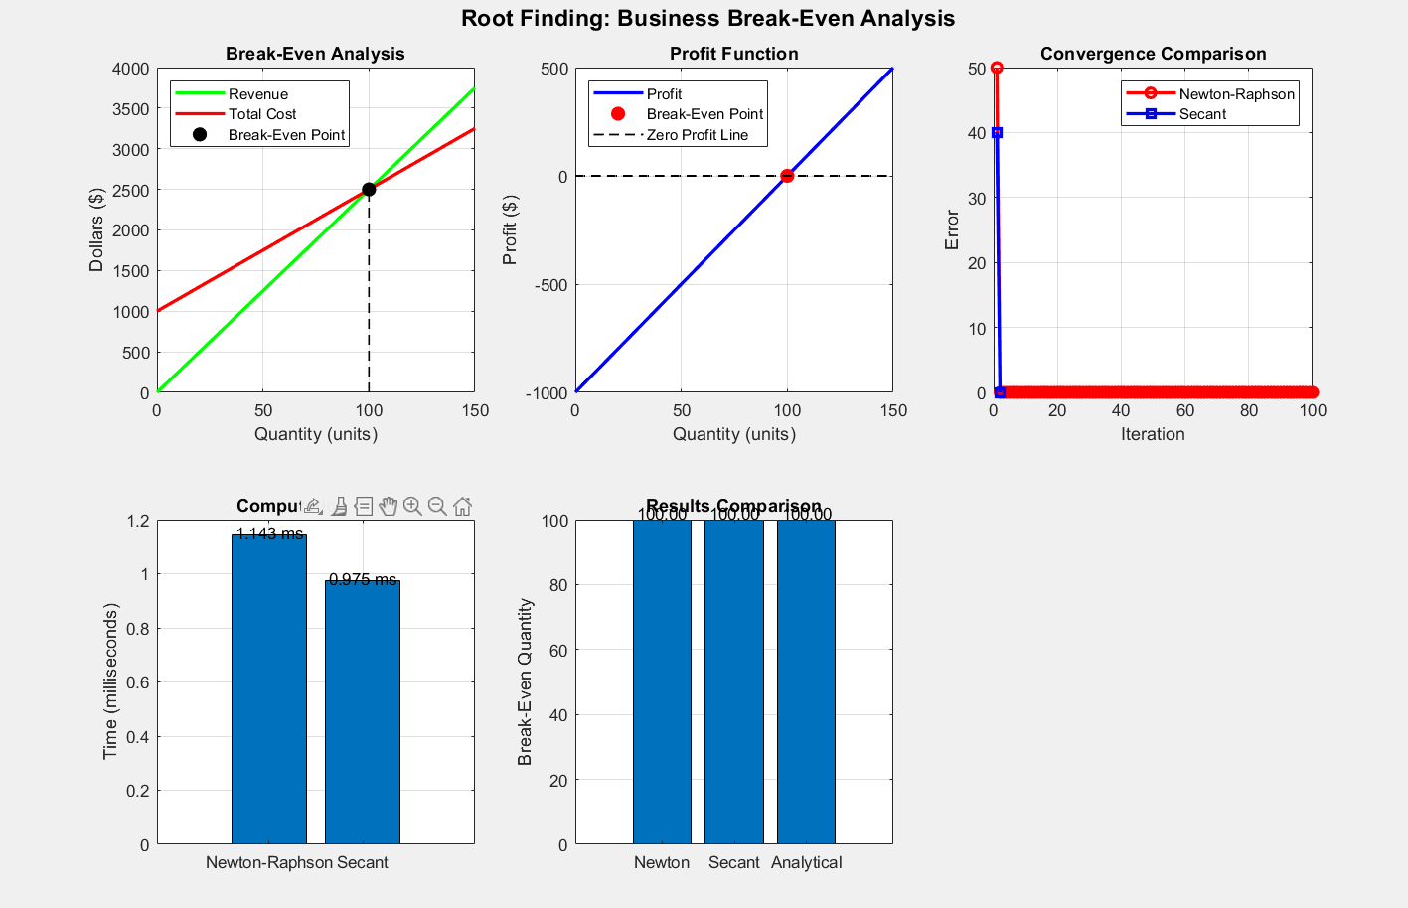
SUBPLOT 1

Slide 16
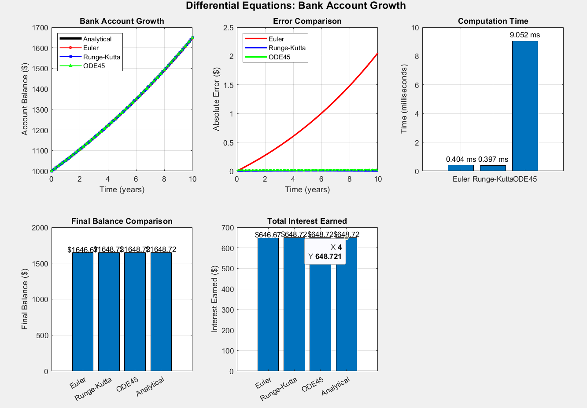
SUBPLOT 2

Slide 17
CONCLUSION
We really appreciate algorithm development, structured programming and also the knowledge obtained from the previous modules 1-4. This experience was of utmost importance to all of us.

